Slide 1
Application Architecture
James Chambers| Senior Software Developer
Simon Timms| Senior Software Developer

Slide 2
Course Topics
Applications on Azure: Putting the Pieces Together
01 | Introduction | 05 | Azure Storage
02 | Application Architecture | 06 | Docker and Log Management
03 | DNS | 07 | AutoScale
04 | Batch | 08 | Review and Summary

Slide 3
Course Topics
Applications on Azure: Putting the Pieces Together
01 | Introduction | 05 | Azure Storage
02 | Application Architecture | 06 | Docker and Log Management
03 | DNS | 07 | AutoScale
04 | Batch | 08 | Review and Summary

Slide 4
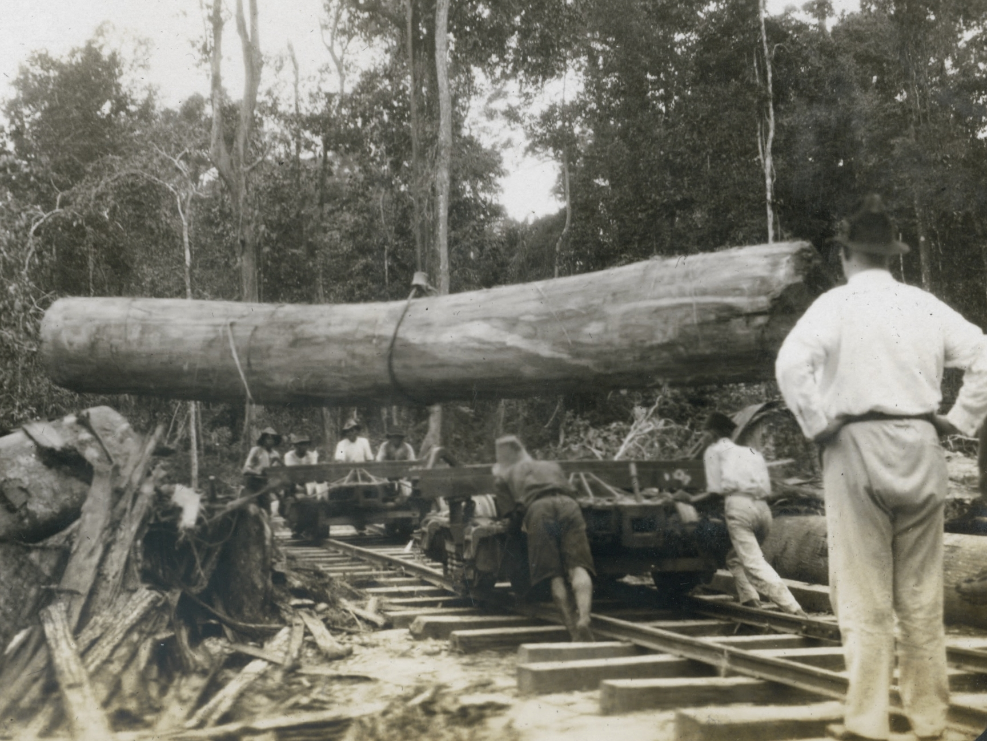
Logging
Please leave this area blank to allow for picture in picture recording
Notes:
Log files are important. We have all sorts of cool shinny tools like App Insights which monitor the current state of a system and give a high level overview of what people are doing but we still need logs. Logs tell us what has happened. When we’re trying to track down a messy bug it is amazingly useful to have good log files in place.
Have you ever had somebody come to you and ask “why is the system in this state?” or “who changed this field” with good log files you can tell them.
If you think about the mediatr pattern we’ve been using we have an ideal place to hook logging into place: the mediator. We can log every command in the system and thusly every change that happened to the data. I use this on some systems in the form of a logging mediator.

Slide 5
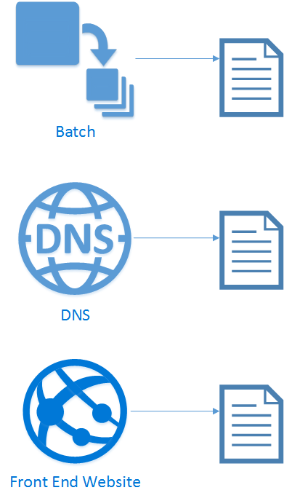
Logging
Please leave this area blank to allow for picture in picture recording
Notes:
Everything we have produces log files. But they are all over the place.

Slide 6
Logging
Please leave this area blank to allow for picture in picture recording
JSON
Flat file
IIS
Notes:
What’s worse is that everything we produce is in a different format

Slide 7
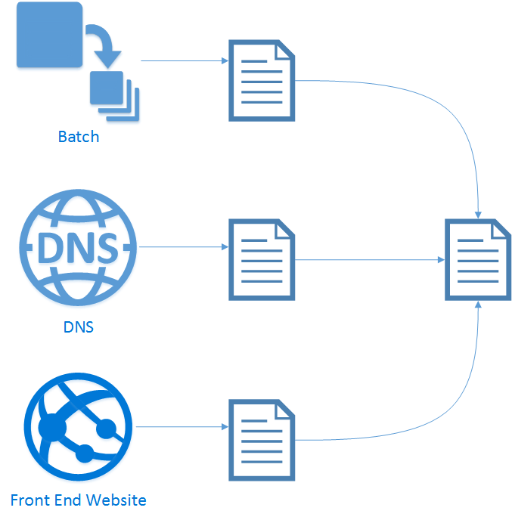
Logging
Please leave this area blank to allow for picture in picture recording
Notes:
We need to find some way to get them all to the same place and the same format

Slide 8
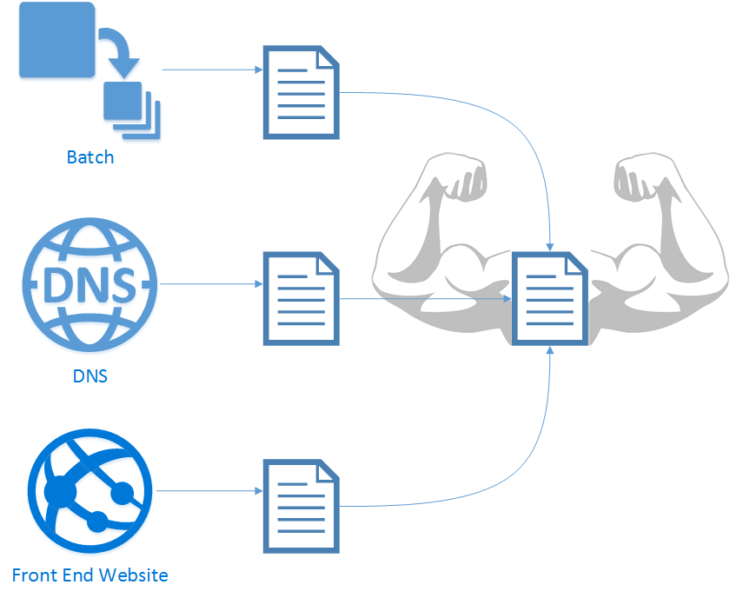
Logging
Please leave this area blank to allow for picture in picture recording
Notes:
This one central log file could be our super log file. The place we go to to understand what happened in the system

Slide 9

Logging
Please leave this area blank to allow for picture in picture recording
https://www.flickr.com/photos/saneboy/3617855124
Notes:
Log data can be huge, I mean seriously huge. Consider that if we log every change to data in the mediator then we’re logging at the very least the same amount of data that we’ve got in the system, likely several fold more data. So if your production db is 1TB your logs could be 10TB. Logs can be a big data problem even for system that aren’t “big data”

Slide 10
Solving it
Please leave this area blank to allow for picture in picture recording
Big data solution
Search
Analyze
Correlate actions to results
https://www.flickr.com/photos/saneboy/3617855124
Notes:
So we need big data and because it is so big we can’t just read the files by hand. Unless you really like reading or you have an infinite number of monkeys who are taking a break from writing Twelfth Night. We would also like to be able to analyze the data for oddities or trends. Tools like app insights provide some of this data but they tend to only instrument points that we know to instrument and not everything. So to glean new insights we need to look at data historically. Finally we would like to correlate actions through the system via some sort of correlation id.
Perhaps us Azure ML to analyze log files.

Slide 11
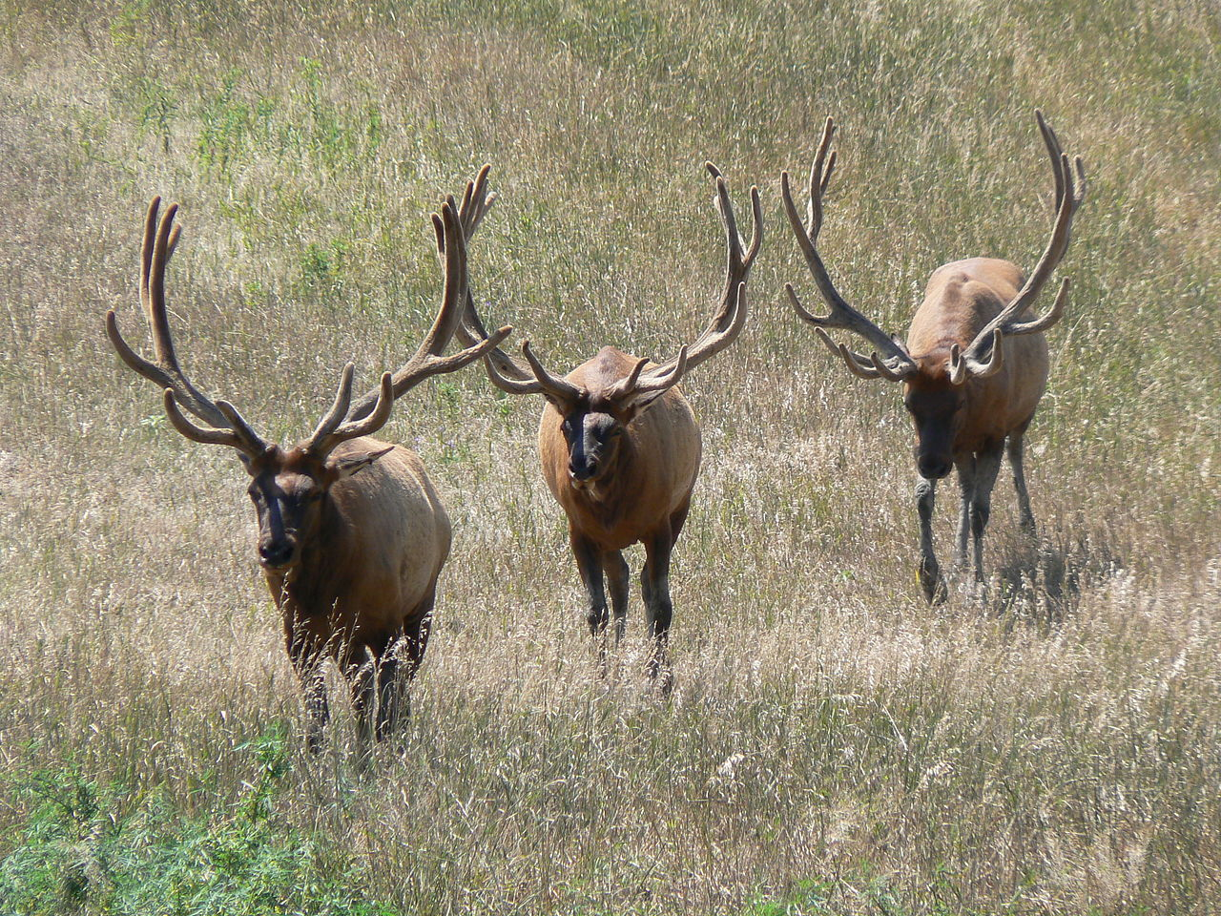
Elasticsearch + Log stash + Kibana
Please leave this area blank to allow for picture in picture recording
ELK stack
"Wapiti.Nebraska". Licensed under CC BY 2.5 via Commons - https://commons.wikimedia.org/wiki/File:Wapiti.Nebraska.JPG#/media/File:Wapiti.Nebraska.JPG
Notes:
Being from Canada we are pretty familiar with this stack. We have whole herds of these things. So do the americans. Don’t confuse them with reindeer and the reindeer stack, that’s a whole different stack. Geeze there are a lot of stacks out there these days MEAN, ELK, LAMP,
Used by lots of people Cisco, Comcast, eBay, Facebook, Goldman Sachs, Groupon, the Guardian, ING, Mayo Clinic, Netflix, Verizon

Slide 12

Logstash
Please leave this area blank to allow for picture in picture recording
Notes:
Let's start with log stash
- log stash is like a sewage plant
-

Slide 13
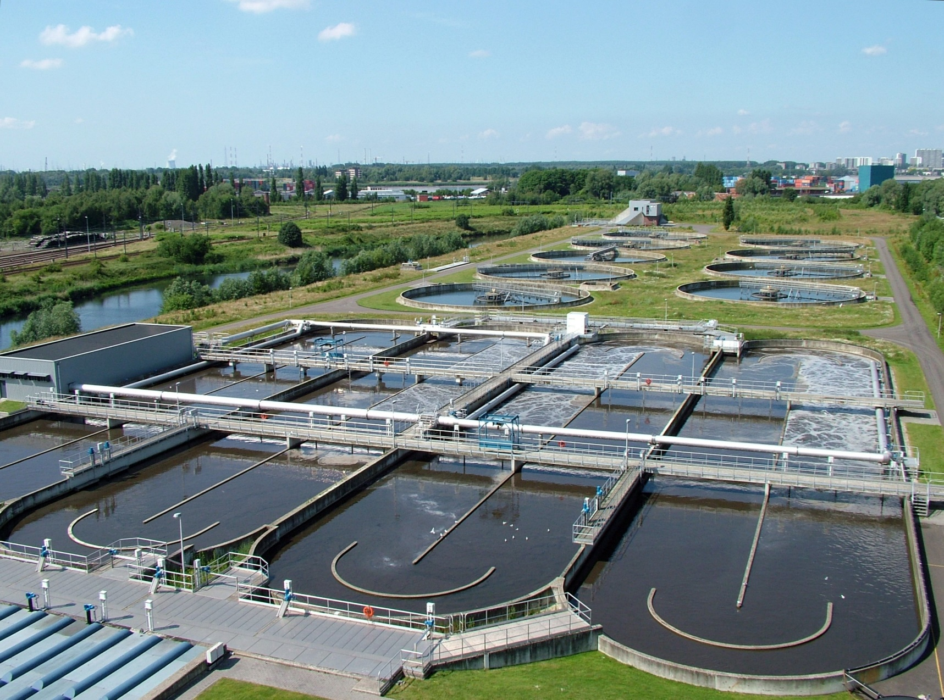
Logstash
Please leave this area blank to allow for picture in picture recording
"WWTP Antwerpen-Zuid" by Annabel - Own work. Licensed under CC BY-SA 3.0 via Commons - https://commons.wikimedia.org/wiki/File:WWTP_Antwerpen-Zuid.jpg#/media/File:WWTP_Antwerpen-Zuid.jpg
Notes:
no no, stay with me.
contains a lot of pipes
message waste comes in and is cleaned and sorted and sometimes we add things to the messages

Slide 14
Sources
Please leave this area blank to allow for picture in picture recording
RabbitMQ
HTTP
Websockets
S3
GitHub
Files
Syslog
Notes:
no no, stay with me.
contains a lot of pipes
message waste comes in and is cleaned and sorted and sometimes we add things to the messages

Slide 15
Filters and mutators
Please leave this area blank to allow for picture in picture recording
Convert IP addresses
Filter out events
Split events
Anonymize
Whatever else you can think of
Notes:
Can run arbitrary code to convert one format to another or whatever your little heart desires. What does 157.45.68.98 tell you about an IP? Nothing. 192.168.1.5? A little bit

Slide 16
Output
Please leave this area blank to allow for picture in picture recording
EMail
Files
Hipchat
Slack
CVS
Elasticsearch
Notes:
Can run arbitrary code to convert one format to another or whatever your little heart desires. What does 157.45.68.98 tell you about an IP? Nothing. 192.168.1.5? A little bit

Slide 17
Elasticsearch
Please leave this area blank to allow for picture in picture recording
Notes:
Apparently elasticsearch is now just called elastic

Slide 18

Elastic
Please leave this area blank to allow for picture in picture recording
Lucene
Schema free
Notes:
Seems like companies don’t like to name things in a way that can be easily found by search engines. A pity.
Most people are using elastic just as a search engine. You can put pretty much anything into it and do fast full text searches. However elastic is built on top of a distributed database. Data is sharded onto multiple nodes in a way that is tolerant to failures of some nodes. It is an eventually consistent system and stresses

Slide 19
Kibana
Please leave this area blank to allow for picture in picture recording
Dashboard for data
Multiple different visualizations
Graphs
Maps
Heat maps
Lists
Search and query capabilities

Slide 20
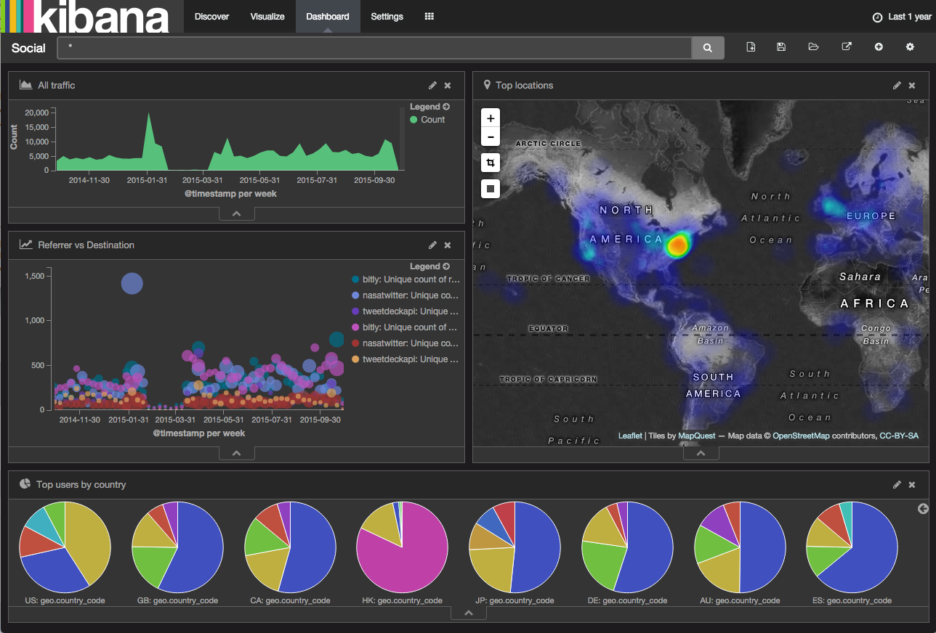
Please leave this area blank to allow for picture in picture recording
https://www.elastic.co/blog/kibana-4-2-0

Slide 21
More moving parts…
☹

Slide 22

Docker to the rescue

Slide 23
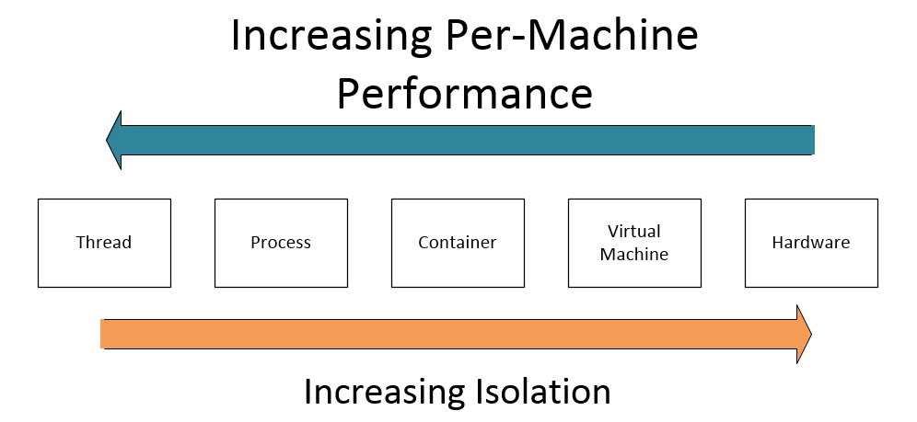
The what, what?
Notes:
Docker is all about isolation. Ramble on for a bit about docker. The library it is built on is libcontainer, libvirt, LXC, system-nspan
“By using containers, resources can be isolated, services restricted, and processes provisioned to have an almost completely private view of the operating system with their own process ID space, file system structure, and network interfaces. Multiple containers share the same kernel, but each container can be constrained to only use a defined amount of resources such as CPU, memory and I/O.” -wikipedia

Slide 24

Docker Machine
https://github.com/docker/machine
Notes:
Handles stacking docker on top of a vm. Facilitates talking to the docker images easily

Slide 25

Docker Swarm
https://github.com/docker/machine
Notes:
A bunch of whales. Provides an abstraction over multiple machines so you can throw up a bunch of docker images without having to worry about which machine is running it or load balancing or any of that. Docker on azure will be compatible with swarm

Slide 26
Deploying to Azure using ARM
Azure Resource Manager
Notes:
JSON based desired state configuration for resource groups

Slide 27
Great Reads
Please leave this area blank to allow for picture in picture recording
https://aphyr.com/posts/317-call-me-maybe-elasticsearch
https://www.youtube.com/watch?v=91cIyipiKAk&index=3&list=PL5GivWTz0TB0Gm-8yYpiA3e0MG-bi_lPy
Notes:
Seems like companies don’t like to name things in a way that can be easily found by search engines. A pitty.
Most people are using elastic just as a search engine. You can put pretty much anything into it and do fast full text searches. However elastic is built on top of a distributed database. Data is sharded onto multiple nodes in a way that is tolerant to failures of some nodes. It is an eventually consistent system and stresses

